Slide 1

Bit Manipulation
LECTURE 8

Slide 2
Bit Manipulation
Bit manipulation is the process of performing operations directly on individual bits (0 and 1) of data to achieve efficient and low-level computation.
Bit manipulation is used to control data at the smallest level (bit level). Since computers internally work in binary form, manipulating bits directly makes programs faster and more efficient.
It is commonly used in:
Embedded systems
Graphics processing
Cryptography
Performance optimization

Slide 3
In assembly language, bit manipulation is done using:
Shift instructions
Rotate instructions
Logical operations (AND, OR, XOR, NOT)

Slide 4
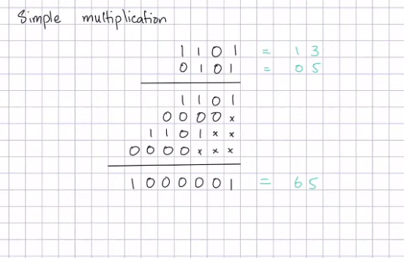
Multiplication Algorithm The multiplication algorithm in assembly is a method of performing multiplication using binary operations such as shifting and addition

Slide 5
Shifting Operations
Shifting is the process of moving bits of a binary number to the left or right

Slide 6
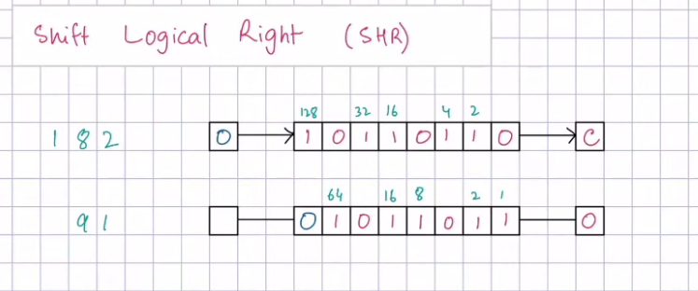
Shift Left (SHL)
SHL shifts all bits to the left and inserts 0 in the least significant bit.
SHL AX, 1
Effect:
Multiply by 2
Leftmost bit goes to carry flag

Slide 7
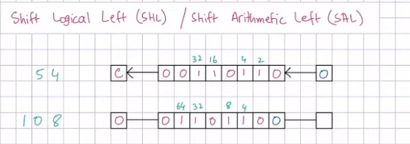
Shift Right (SHR)
SHR shifts bits to the right and inserts 0 in the most significant bit.
SHR AX, 1
Effect:
Divide by 2

Slide 8
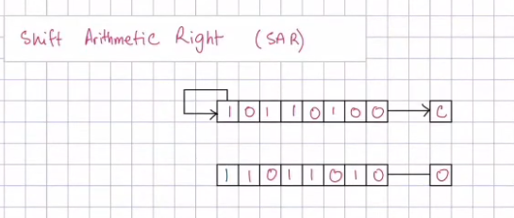
Arithmetic Shift Right (SAR)
SAR shifts bits right while preserving the sign bit.
Used for signed numbers

Slide 9
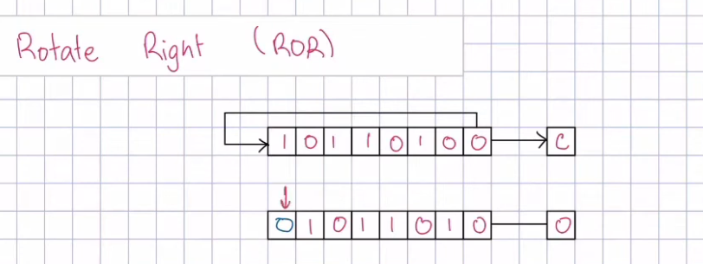
Rotation Operations Rotation is the process of circularly shifting bits where bits leaving one end re-enter from the other.

Slide 10
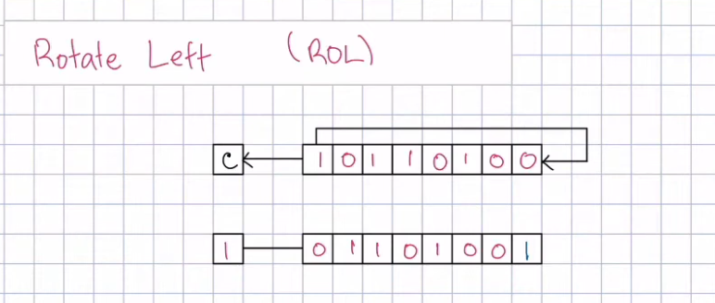
ROL AL, 1
MSB moves to LSB

Slide 11
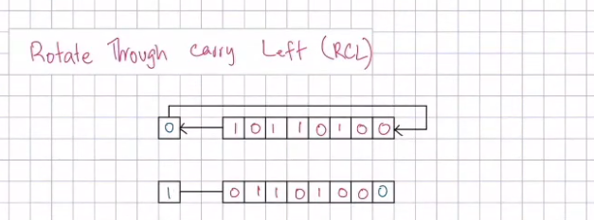
RCL / RCR Rotate through carry flag

Slide 12
Multiplication in Assembly
Multiplication in assembly language is performed using special instructions such as MUL (unsigned) and IMUL (signed).
MUL (Unsigned)
MOV AL, 5 MOV BL, 3 MUL BL
Result stored in AX

Slide 13
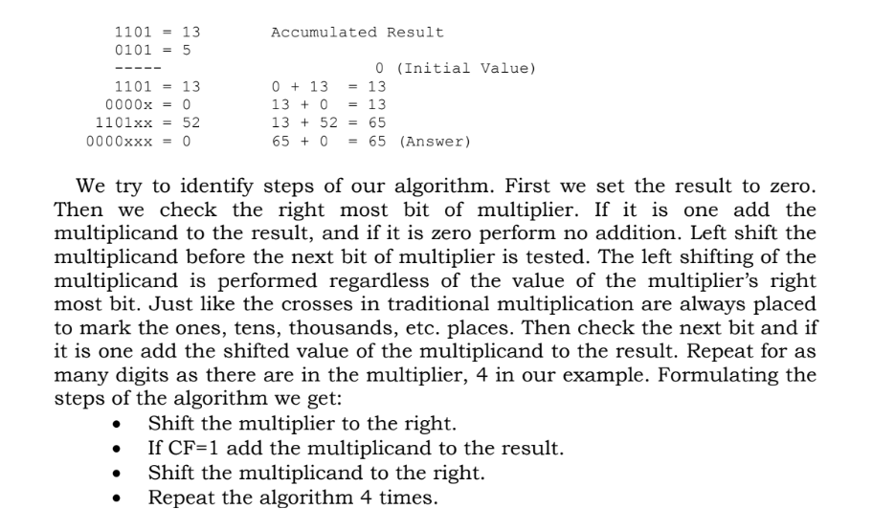

Slide 14
